Slide 1



Secure Communication
4224
A secure connection is cryptographically protected against attackers trying to read or manipulate the transferred data.

Slide 2


Data transferred in the network cannot be read by anyone but the intended recipient.
SIC Expert is a configuration tool for secure network communication. It allows you to configure security-enabled instruments and VISA libraries on test stations.

Slide 3
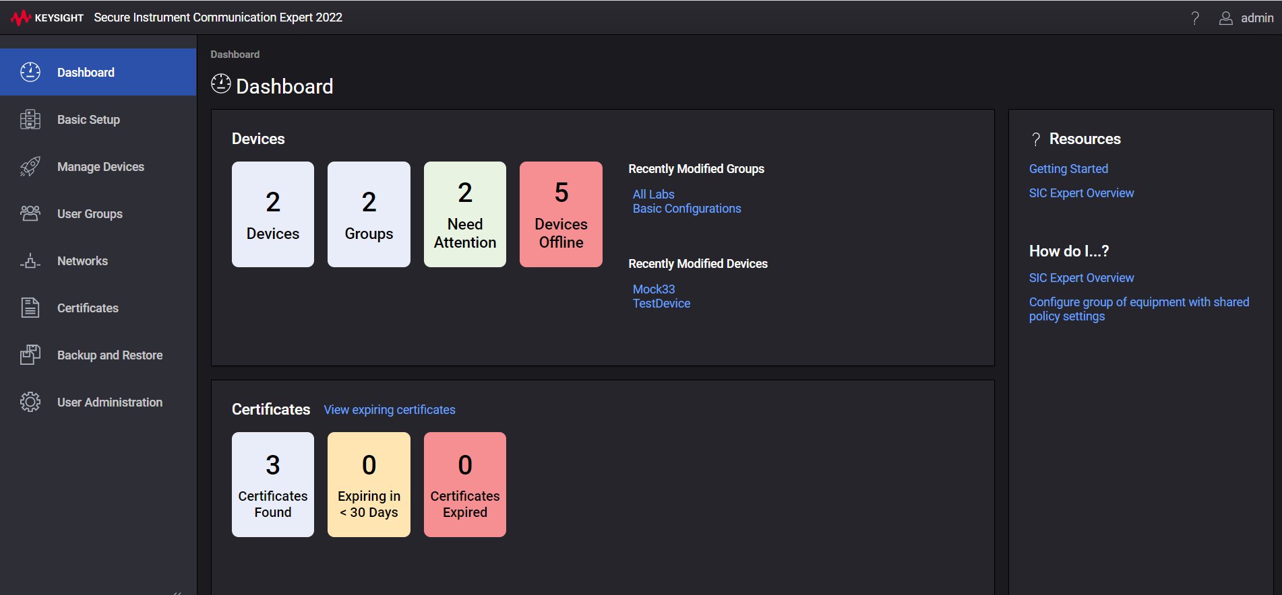


Keysight Secure Communication
SIC Expert is a configuration tool for secure network communication. It allows you to configure security-enabled instruments and VISA libraries on test stations.
A secure connection is cryptographically protected against attackers trying to read or manipulate the transferred data.

Slide 4


A secure connection is cryptographically protected against attackers trying to read or manipulate the transferred data.
Data transferred in the network cannot be read by anyone but the intended recipient.

